Slide 1


Modern Topics in IT Assignment 03
Group ID: MTIT-032

Slide 2
Group Details
Registration No | Name | Email
IT20127114 | Kaluarachchi P. L. | it20127114@my.sliit.lk
IT20246228 | Ranaweera E. T. M | it20246228@my.sliit.lk
IT20115302 | Wadasinghe D. V. | it20115302@my.sliit.lk
IT20004286 | Amarasinghe J. V. A. | it20004286@my.sliit.lk

Slide 3
Explanation of API Gateway Usage
A server that serves as a lone entry point for a collection of microservices or backend services is known as an API gateway. It handles duties like routing, load balancing, and protocol translation in addition to serving as a centralized point of management for administering and securing APIs.
In microservices designs, where services are divided into smaller, independent components that may be created, deployed, and scaled independently, API gateways are frequently utilized. An API gateway is used in such designs to manage and coordinate interactions between the services and clients. Each service in such architectures typically exposes its own API.

Slide 4
API gateways offer several benefits for both API providers and consumers. Some of the key advantages include:
Enhanced performance: -
To enhance performance and availability, an API gateway can cache replies from backend services and offer load balancing and traffic control features.
2. Increased Security: -
An API gateway can offer authentication and authorization services, preventing unwanted access and assaults on backend services.
3. Centralized management: -
A centralized point of control for managing and protecting APIs is offered by an API gateway. This makes it simpler to handle API usage regulations such as rate limits, access controls, and others.

Slide 5
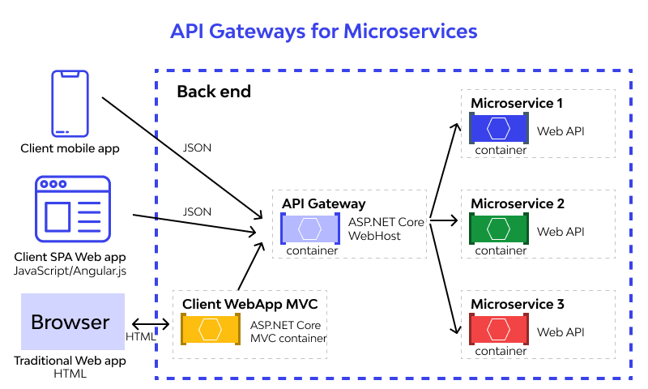

Slide 6
Microservices
Customer Microservice
Add Customer
View Customer
Search Customer
Update Customer
Delete Customer
Payment Microservice
Add Payment
View Payment
Search Payment
Update Payment
Delete Payment
Event Microservice
Add Event
View Event
Search Event
Update Event
Delete Event
Content Providers Microservice
Add Content Provider
View Content Provider
Search Content Provider
Update Content Provider
Delete Content Provider

Slide 7
Create: This is the procedure of adding new data to a database or application. It involves adding new information to the system, including adding a new customer, payment, event and content providers.
Update: This is the process of changing the data that already exists in a database or application. It involves modifying current data in the system, such as updating the customer information, payment details, event details and content provider details.
Delete: This is a reference to the removal of data from a database or application. It involves removing current data from the system, such as deleting a customer, payment, event and content providers.
Search: The Search function of CRUD refers to the action of retrieving data from a database or application. This function involves searching for and retrieving existing data from the system, such as displaying customers, payment details, events and content providers.

Slide 8
Elaborate how to avoid having multiple ports
A gateway is used in a microservices architecture to route client requests to the appropriate service. Without a gateway, clients need to be aware of the location and other details of each service they want to connect, which would make things more complicated and restrict their options.
However, employing a gateway has the drawback of exposing many ports to the outside world, which poses security risks and complicates to manage traffic. To avoid having multiple ports with the gateway, reserve proxy can be used to address the issue.

Slide 9
Reverse Proxy:
It is possible to simplify communication between the client and the microservices, avoid having multiple ports for each microservice, and provide other functionalities like load balancing, caching, and security by using a reverse proxy as a gateway.
Nginx, Apache, and HAProxy are just a few of the widely used reverse proxy options. These solutions are compact, effective, and conveniently set up to work with microservices.

Slide 10
IT20127114 - Customer Microservice
The client is anyone who wants to place bets on a specific sport, event, or game, whether they are an individual or a group of people. Customers often engage with the system in order to obtain the services and having a micro-service to handle the customer tasks helps to improve the scalability, dependability, and security of the main program.
According to the Customer Microservice, customer details can view, add, update, search, and delete according to the requirement. Clients may also need to provide personal information to the betting company in order to place bets and receive winnings. New customer is added by entering details such as specific id, name, country, and age.

Slide 11
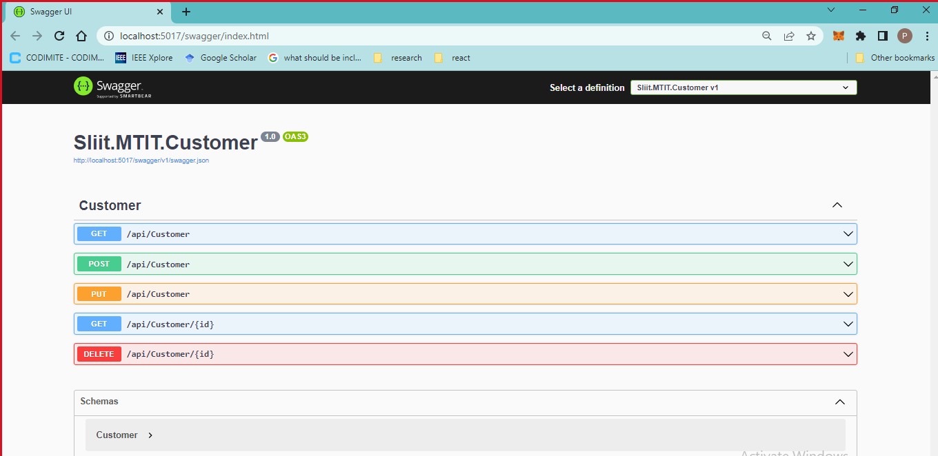

Slide 12
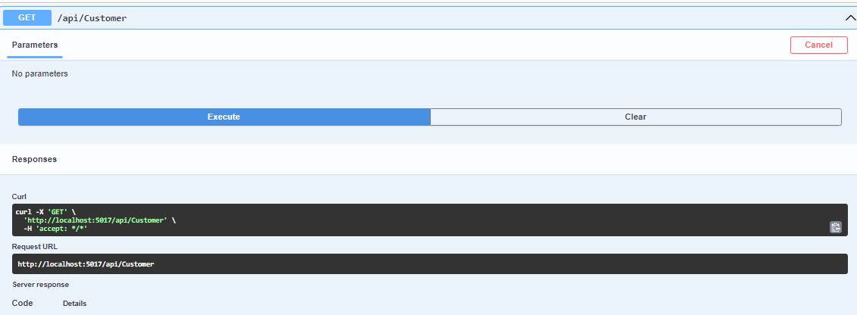
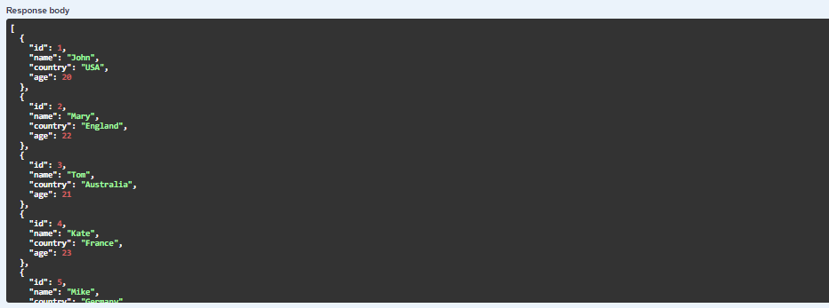
View All Customer Details

Slide 13
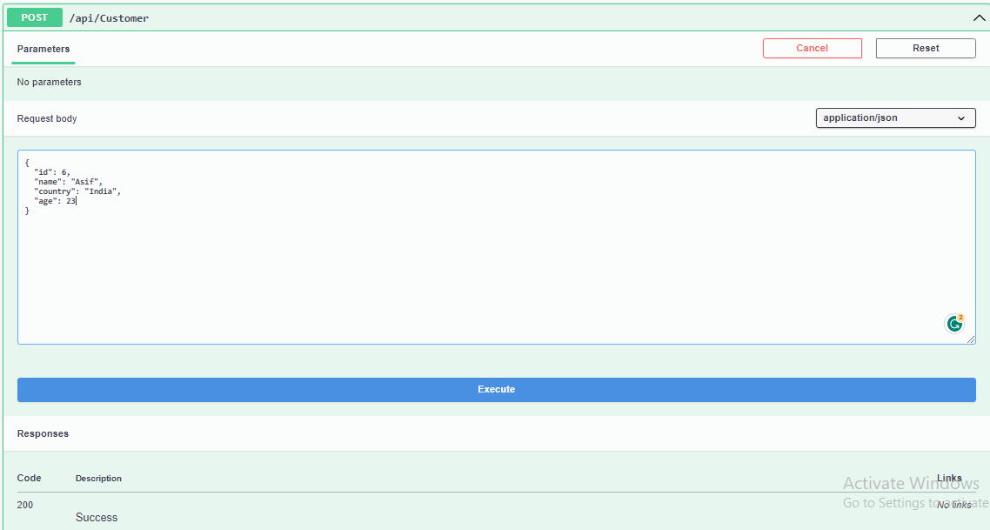
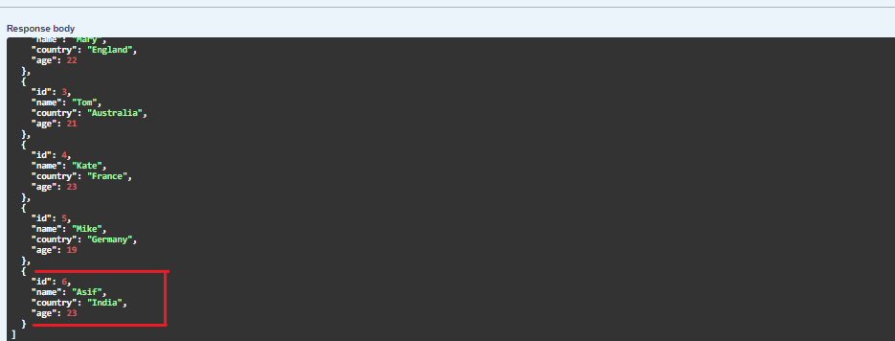
Add New Customer Details

Slide 14
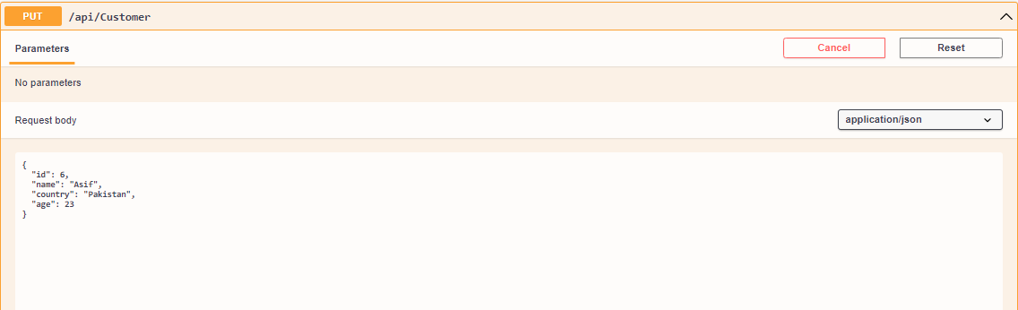
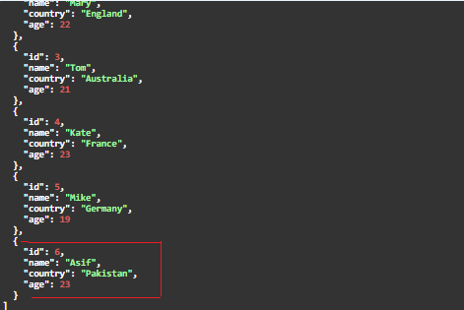
Update Customer Details

Slide 15
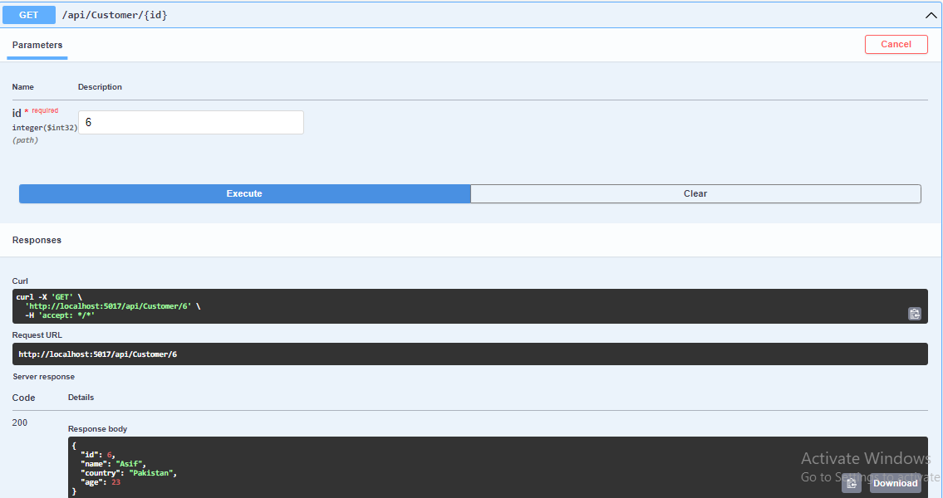
Search Customer Details

Slide 16
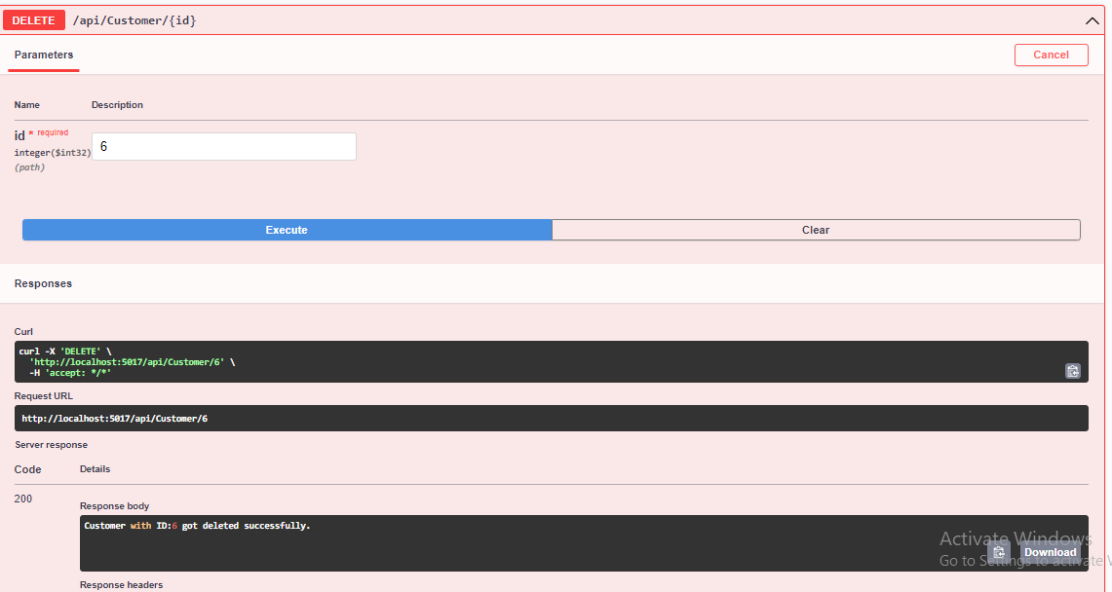
Delete Customer Details

Slide 17
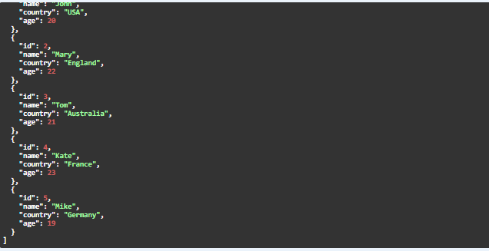
Available Customer Details

Slide 18
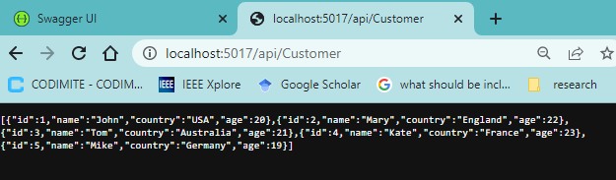
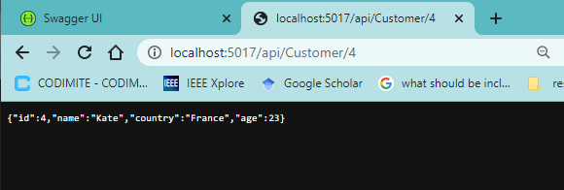
Test the Upstream Customer URL in Browser

Slide 19
IT20246228 - Payment Microservice
A software component known as a payment microservice manages payment transactions as part of a larger application or system.
To process transactions securely and maintain payment information, it often interfaces with payment gateways or other payment processors.
Developers can improve the scalability, dependability, and security of the main program by offloading payment-related tasks to a microservice.
They can also quickly choose between payment processors without the remainder of the application being affected by their choice.
According to the Payment Microservice, users can view, add, update, search, and delete payment details. Furthermore, users can add payment by entering Id, Card number, Expiry date, CVC, and Amount. And also, users can search and delete payments by using the Id.

Slide 20
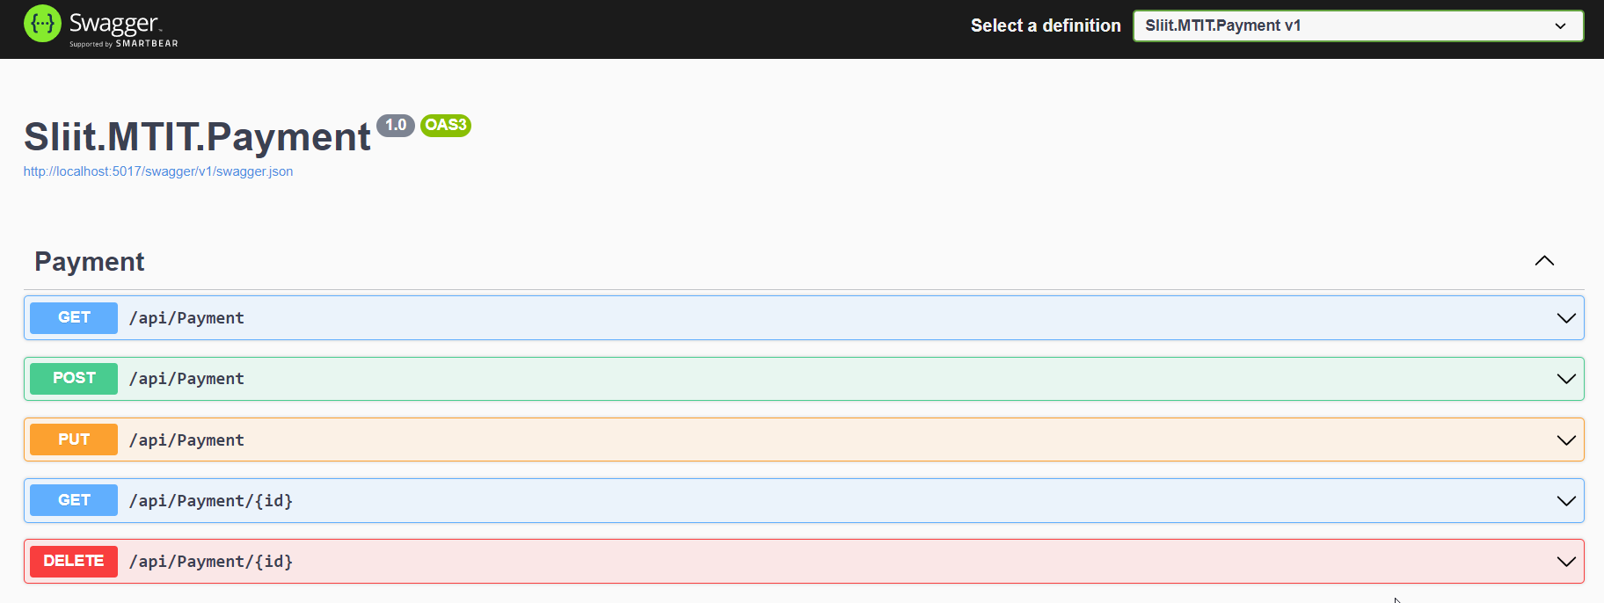

Slide 21
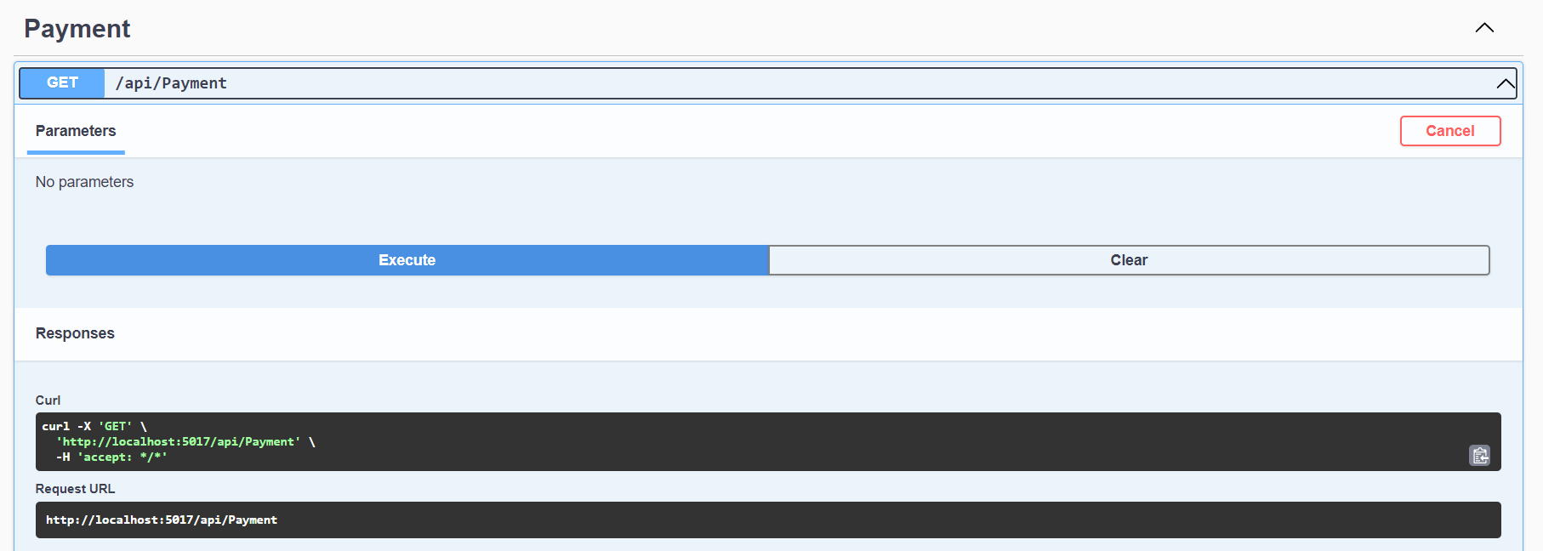
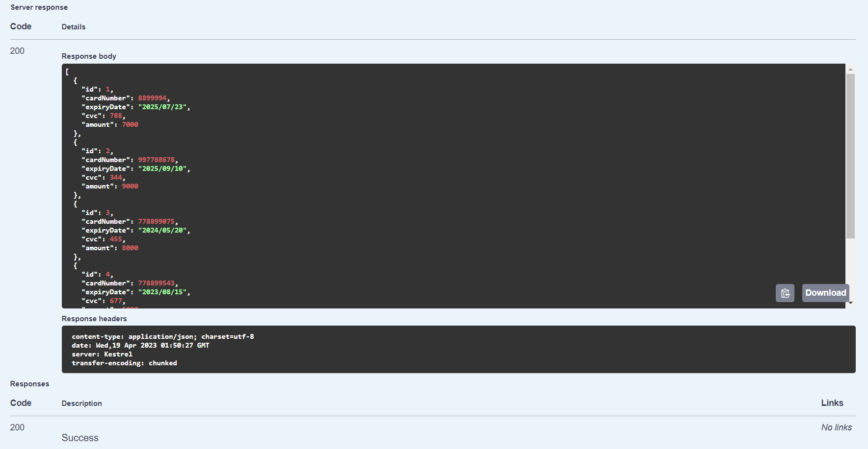
View All Payment Details

Slide 22
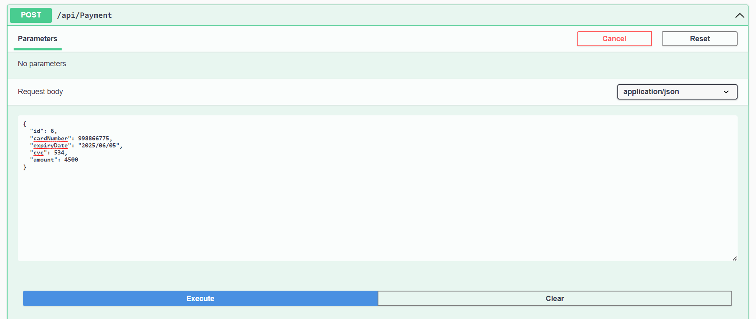
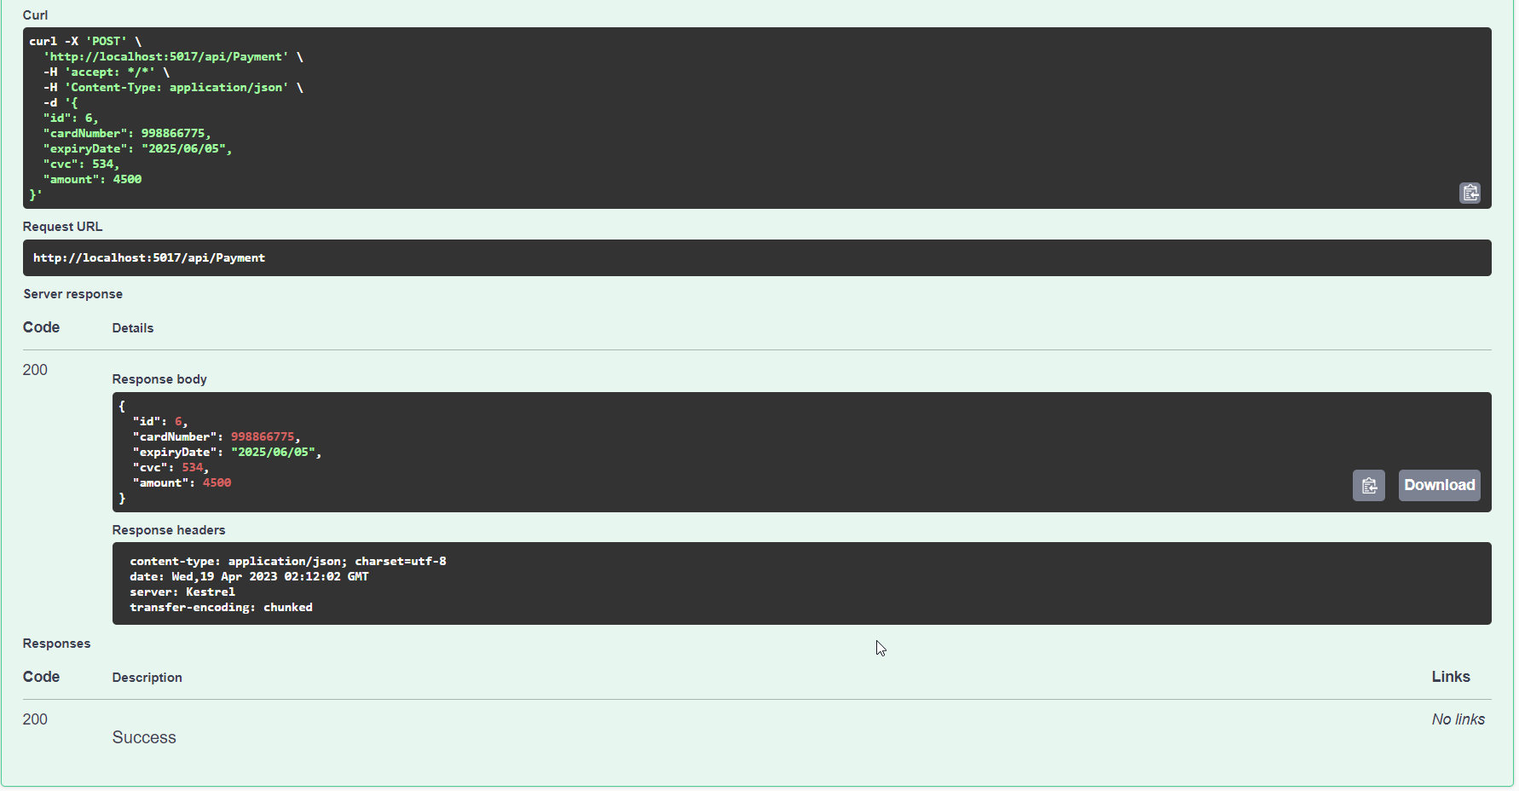
Add Payment Details

Slide 23
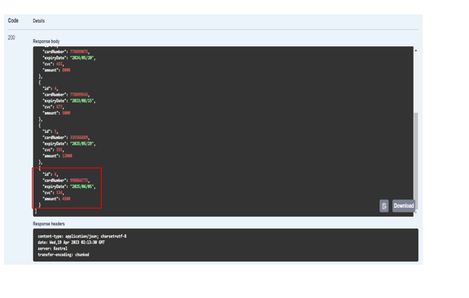
View Newly Added Payment Details

Slide 24
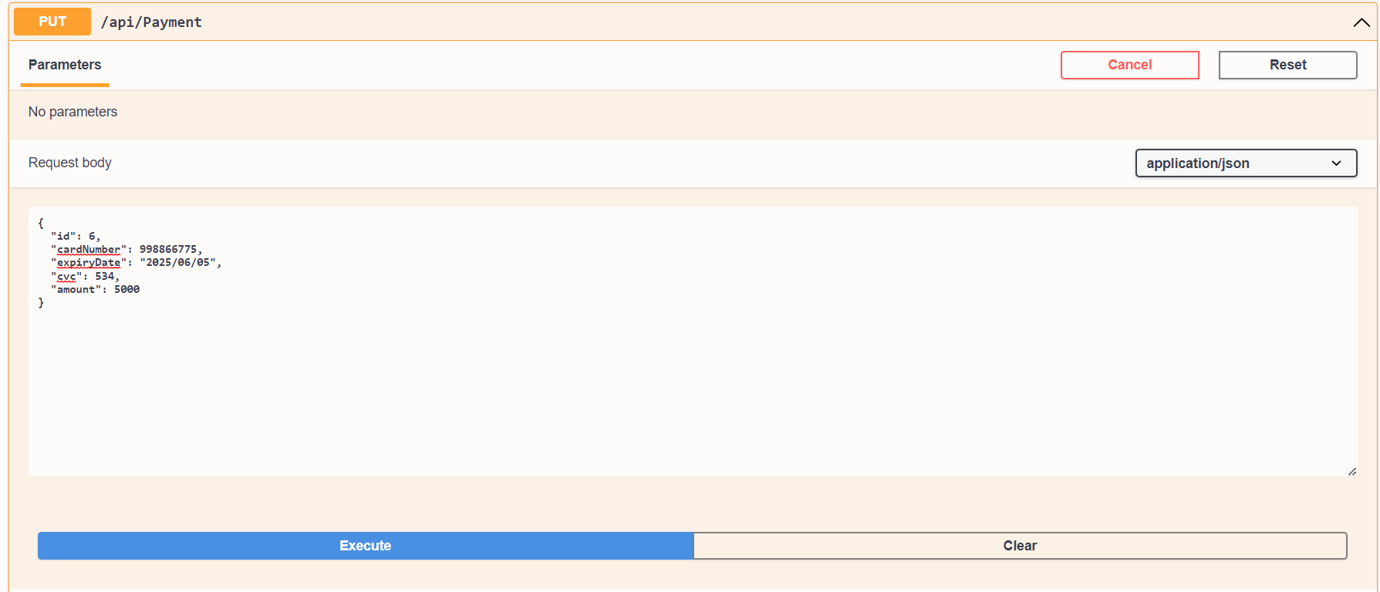
Update Payment Details

Slide 25
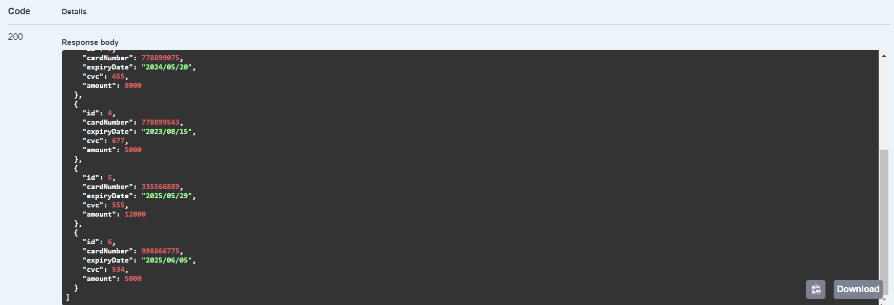
View Updated Payment Details

Slide 26
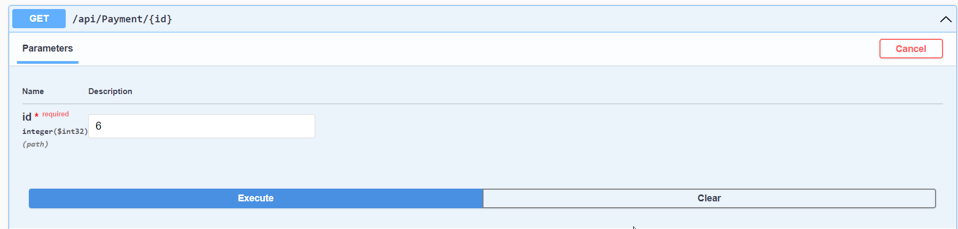
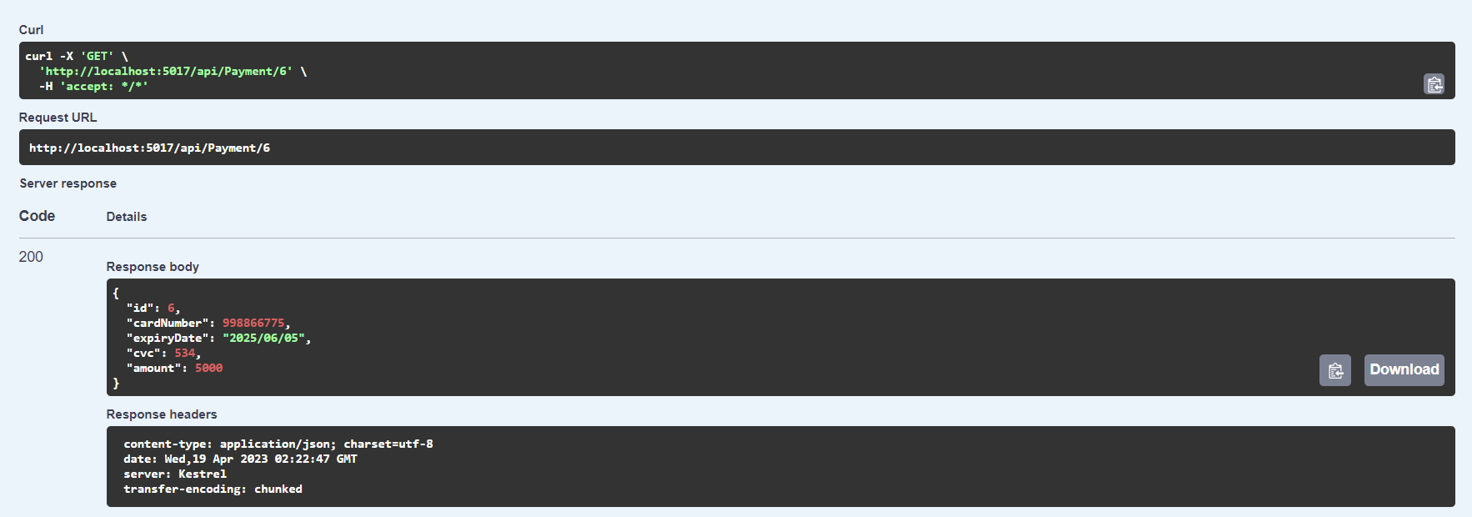
Search Payment Details

Slide 27
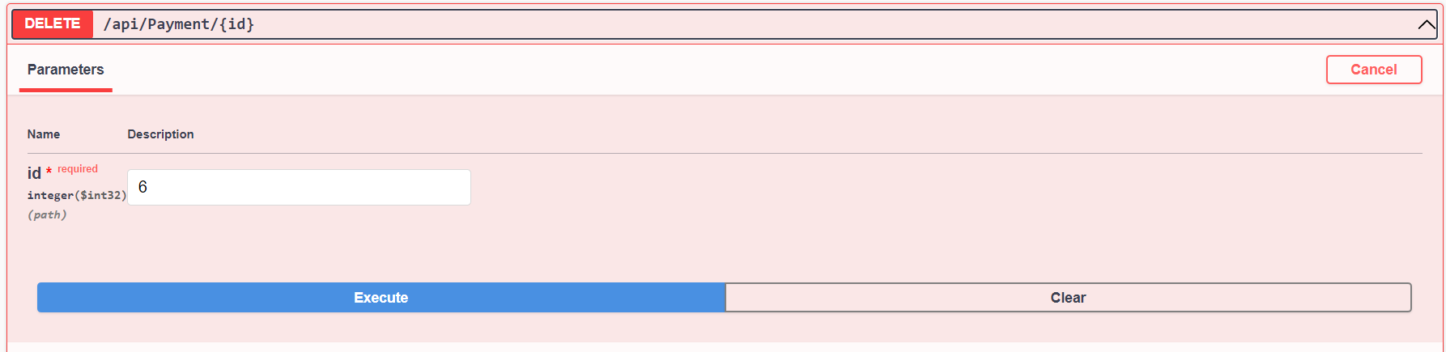
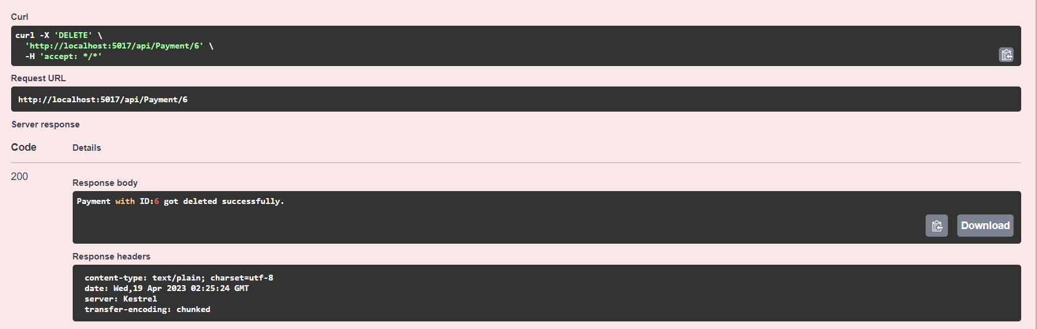
Delete Payment Details

Slide 28
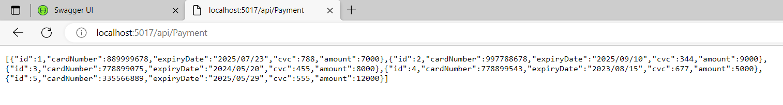
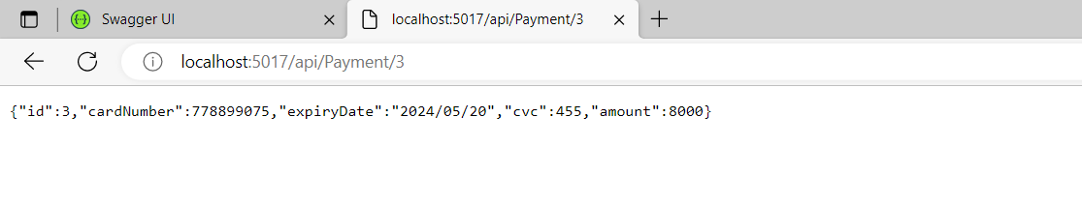
Test the Upstream Payment URL in Browser

Slide 29
IT20115302 – Event Microservice
Utilizing microservices in betting events can be executed in a similar manner to event management systems.
Accordingly, different aspects of the betting process including event creation, betting odds calculation, and payout processing could be done by using microservices.
Organizations could achieve more flexible and ascendable systems which have the capability to alter according to the market conditions in addition to carrying out large number of bets at the same time more efficiently by breaking down the betting system into small scale and easily manageable microservices.
Moreover, better functionality of system could be achieved by merging third party systems which includes payment processors or data providers by using microservices.
Users have the benefit of viewing, adding, updating, searching and deleting event information according to Event Microservice. In addition, the user can add Event by entering Id, Event Name, country, date, and even managing events by searching and deleting them using the Id.

Slide 30
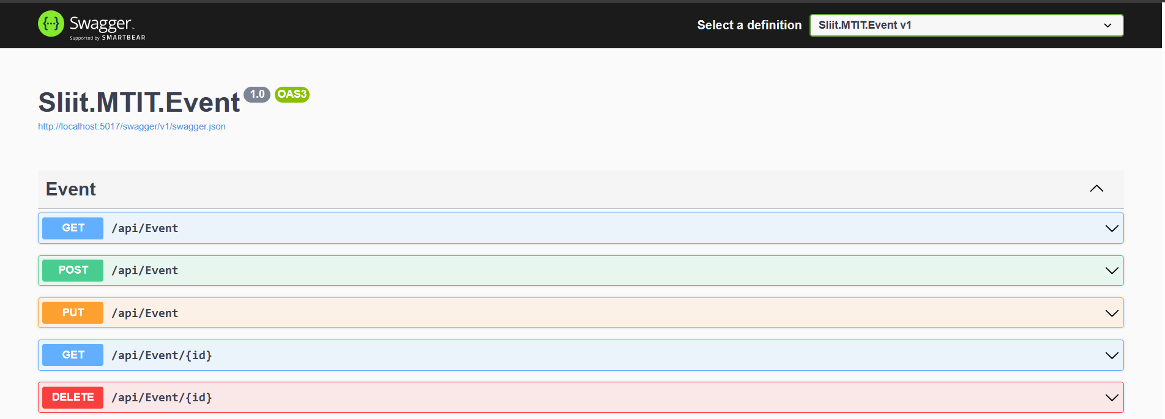

Slide 31
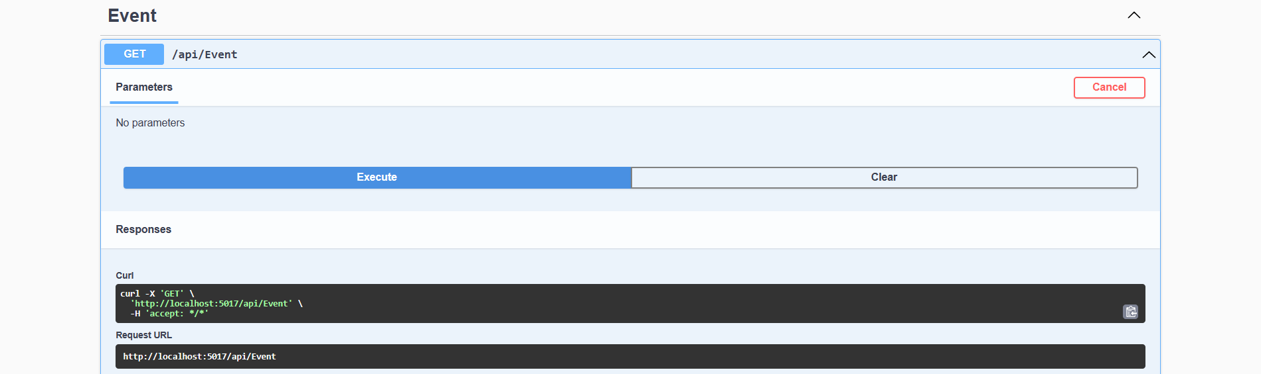
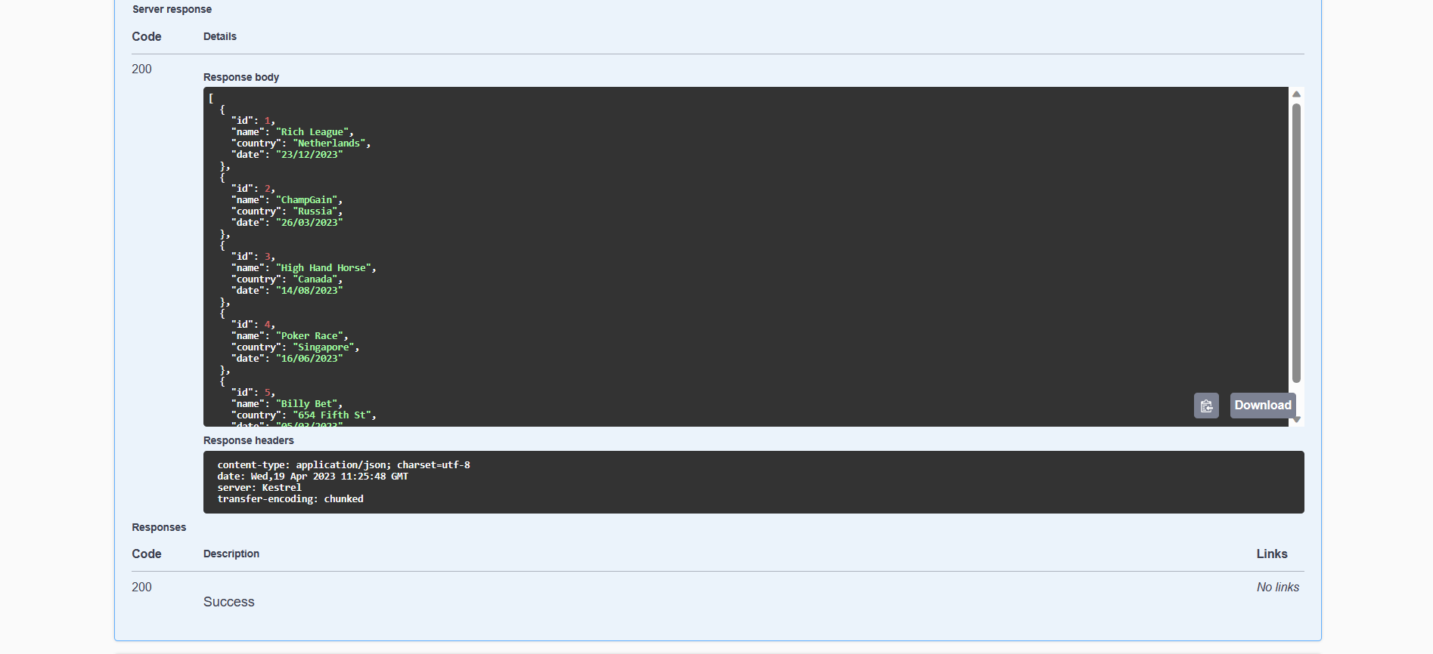
View All Event Details

Slide 32
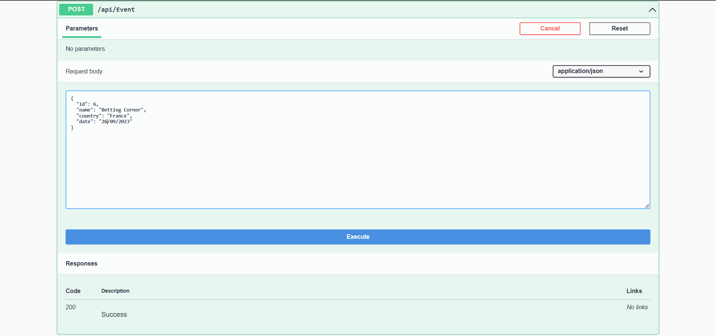
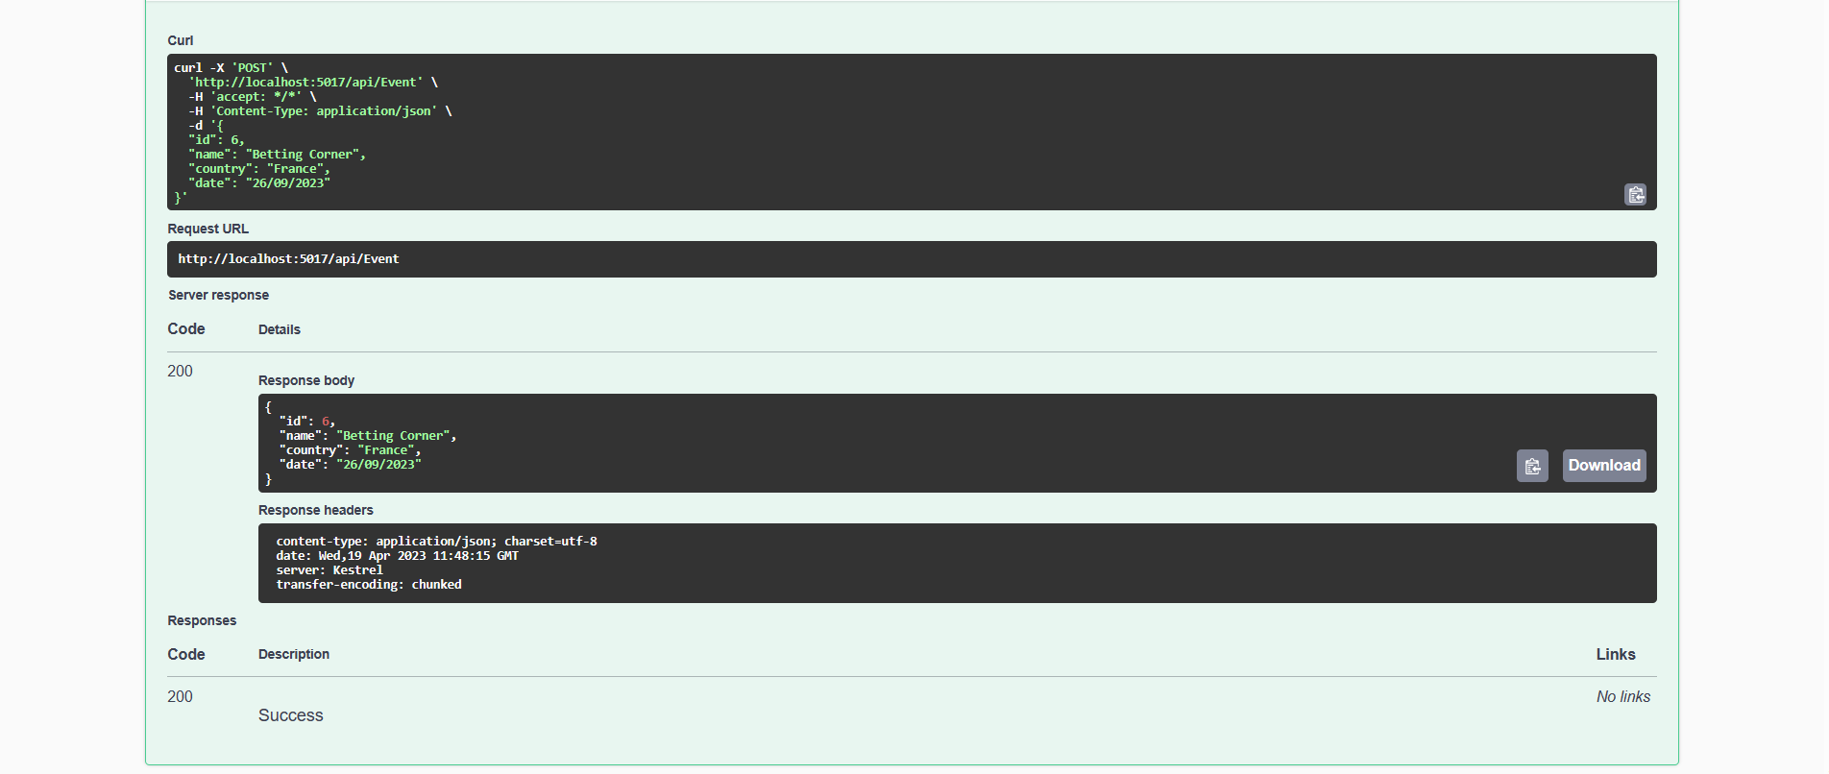
Add Event Details

Slide 33
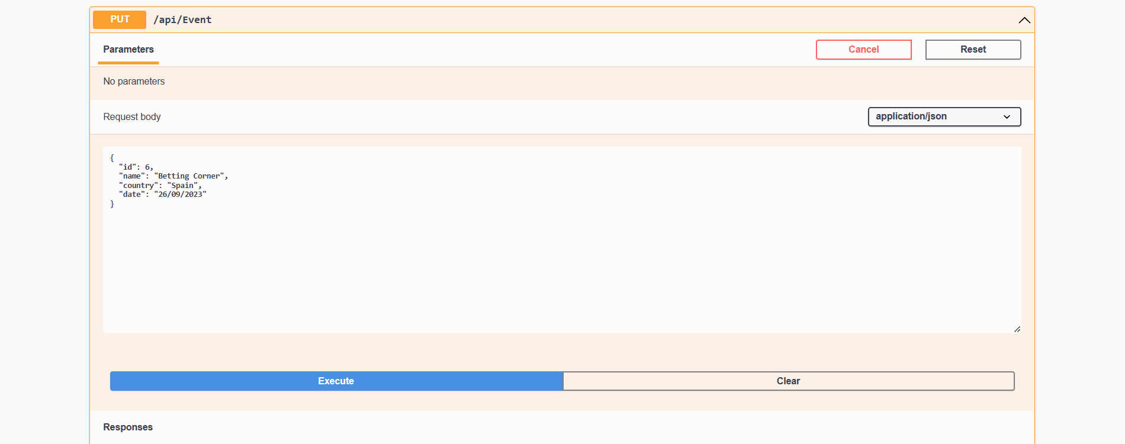
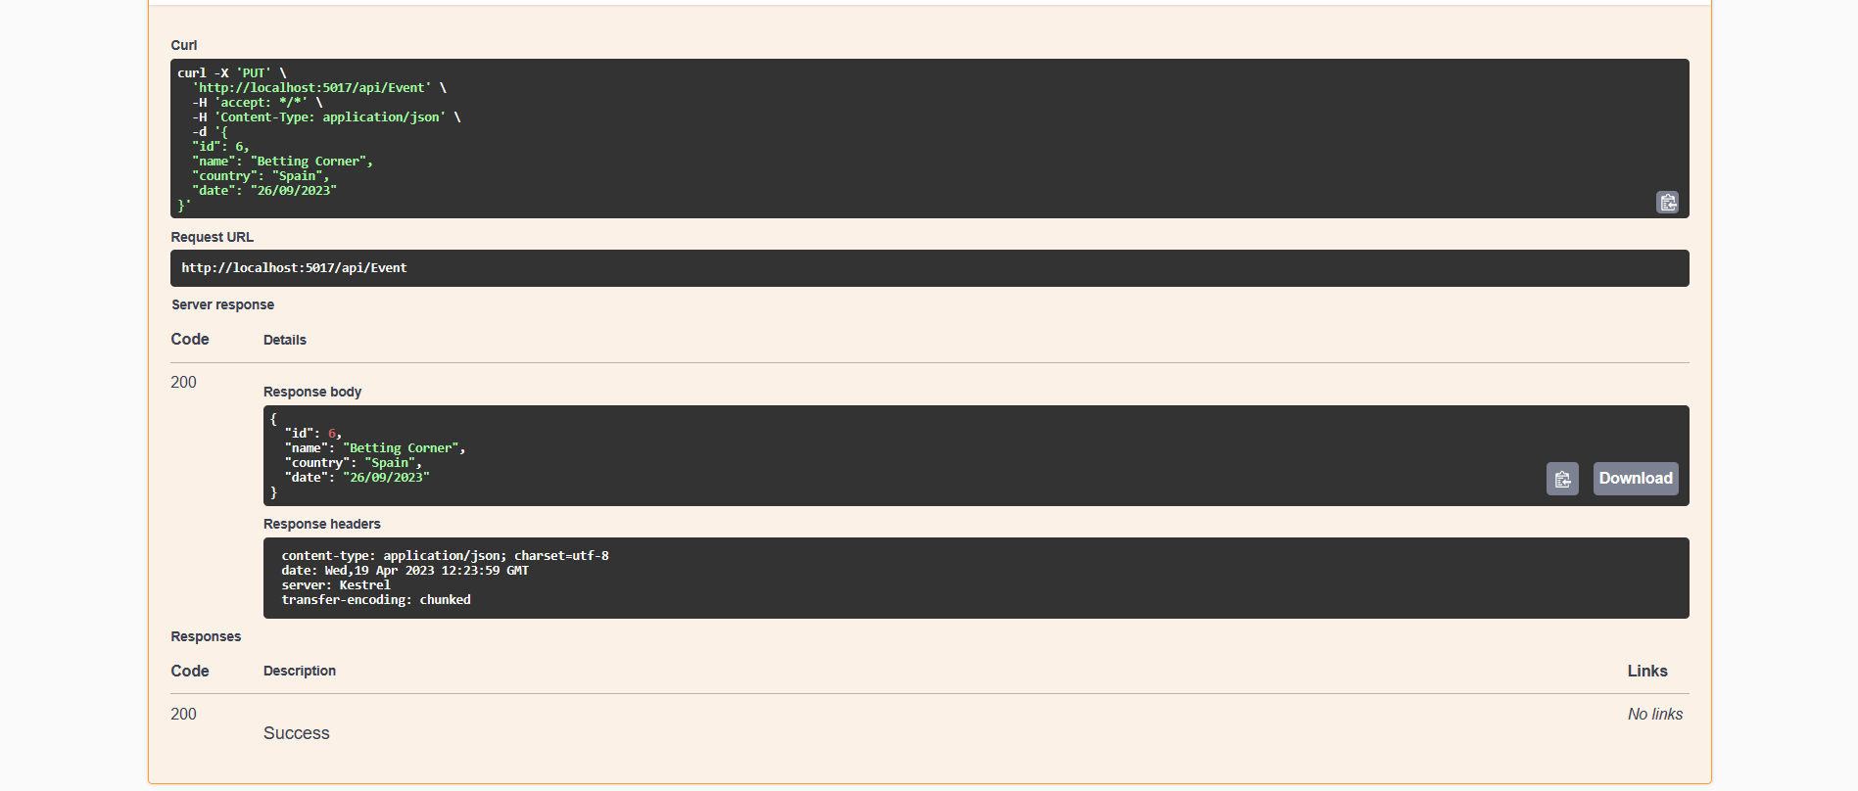
Update All Event Details

Slide 34
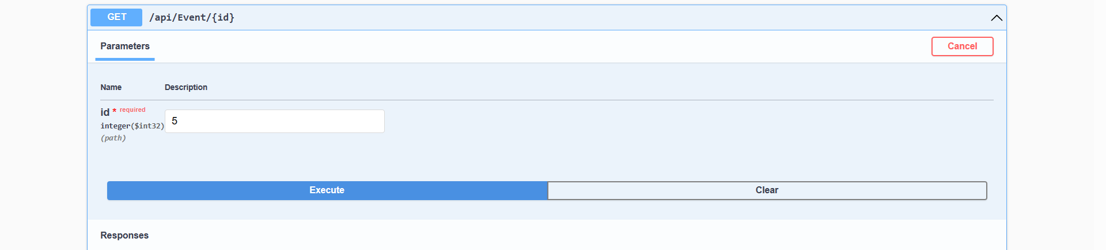
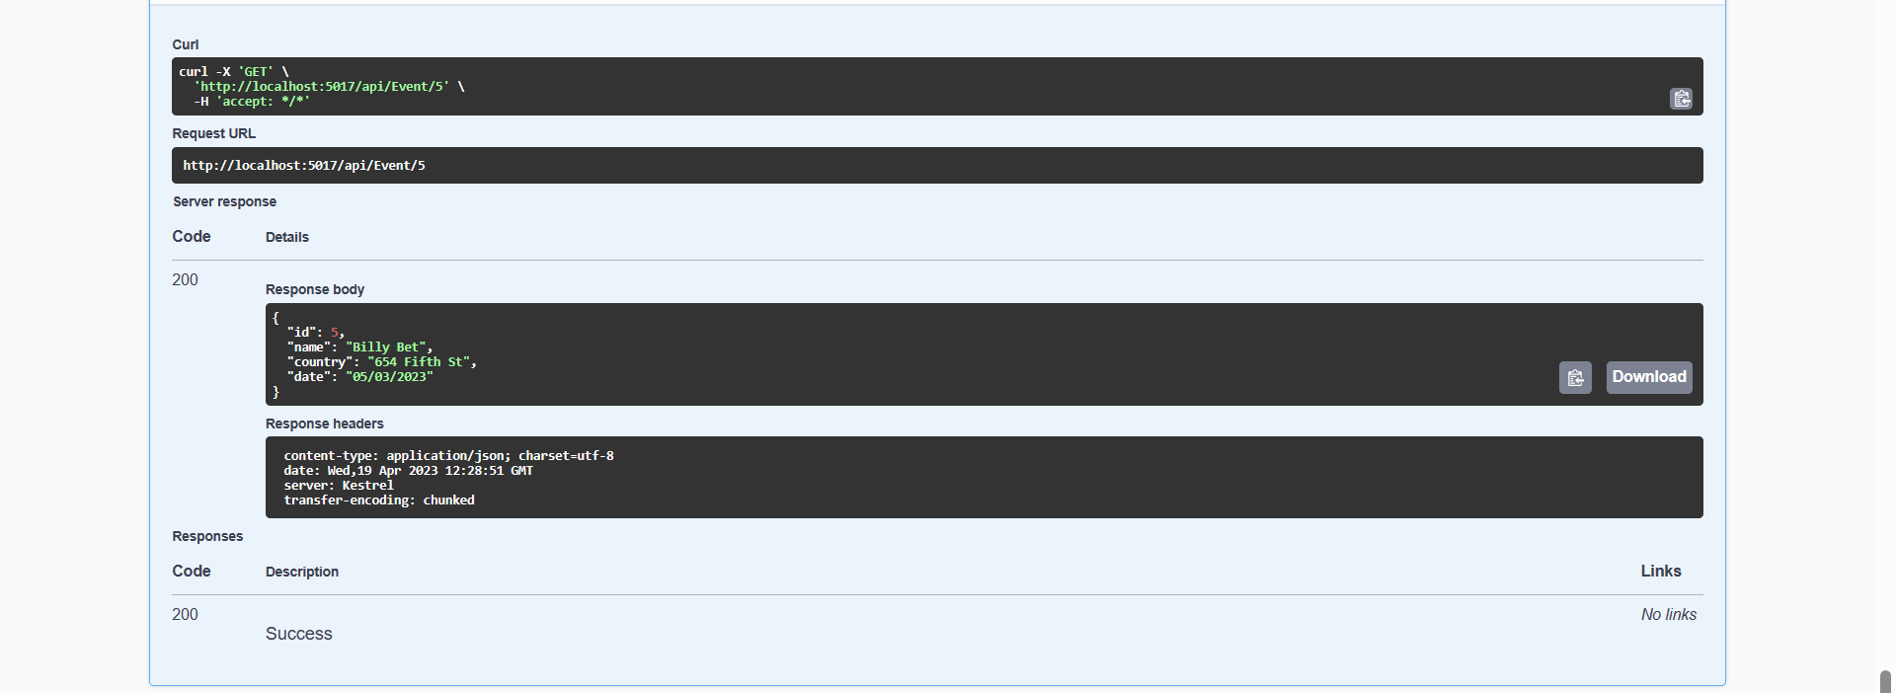
Search Event Details

Slide 35
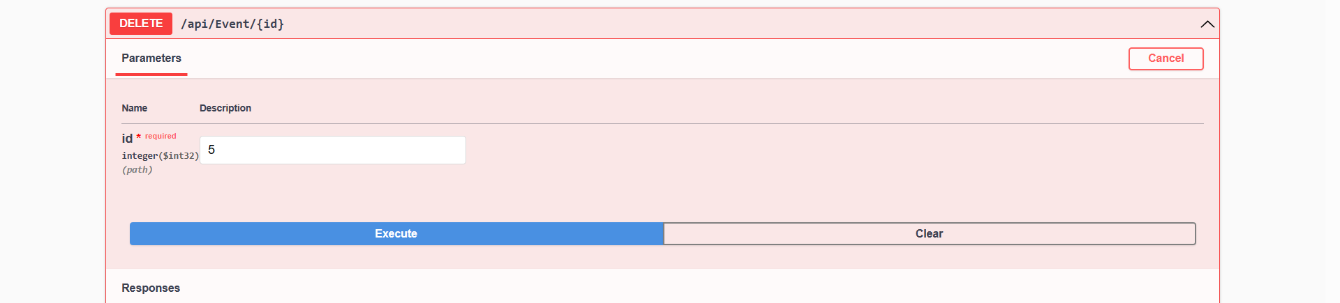
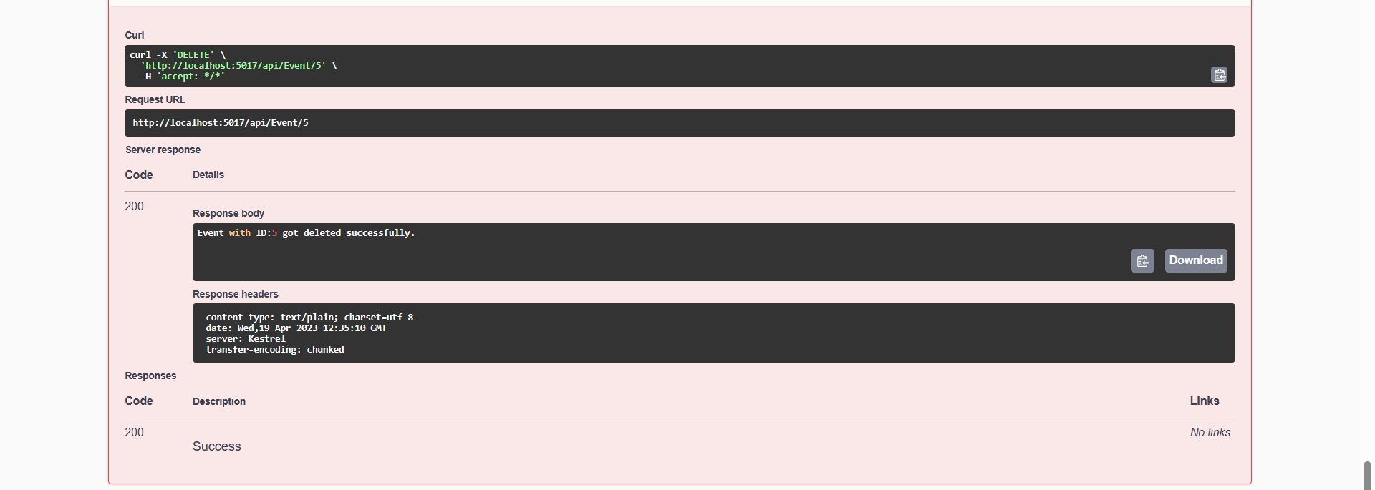
Delete Event Details

Slide 36
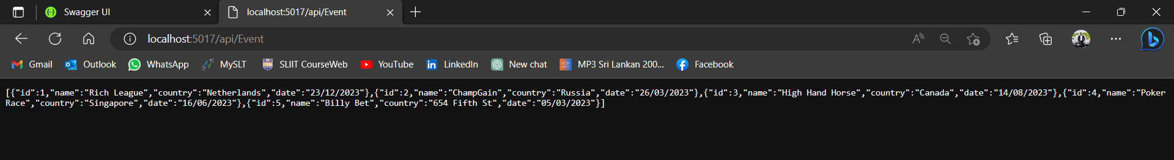
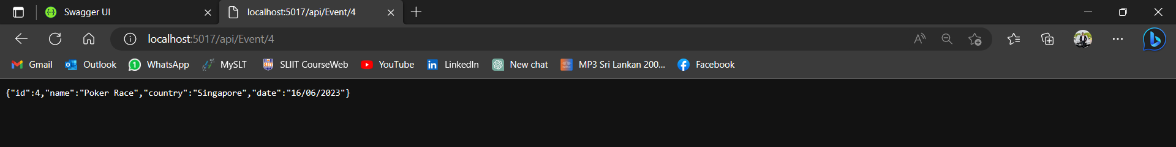
Test the Upstream Event URL in Browser

Slide 37
IT20004286 – Content Providers Microservice
Content providers play a crucial role in the success of a betting organization. They are responsible for creating and managing content related to the organization's contents, which can help attract and retain customers. .
A software component known as a content providing microservice manages content-related tasks as part of a larger application or system.
It can process and manage data securely and interface with data providers or other content providers to maintain content information.
By offloading content-related tasks to a microservice, developers can improve the scalability, dependability, and security of the main program. They can also quickly choose between different content providers without affecting the remainder of the application.
According to the Content Providing Microservice, users can view, add, update, search, and delete content details. Furthermore, users can add content by entering relevant data, and they can search and delete content by using specific identifiers.

Slide 38
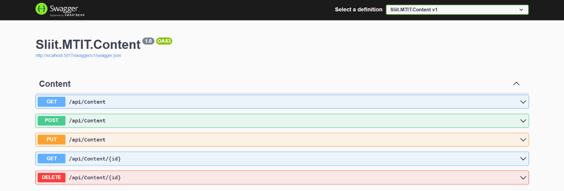

Slide 39
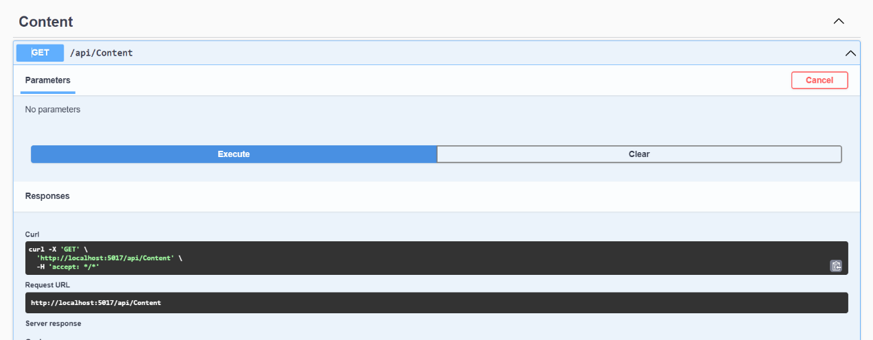
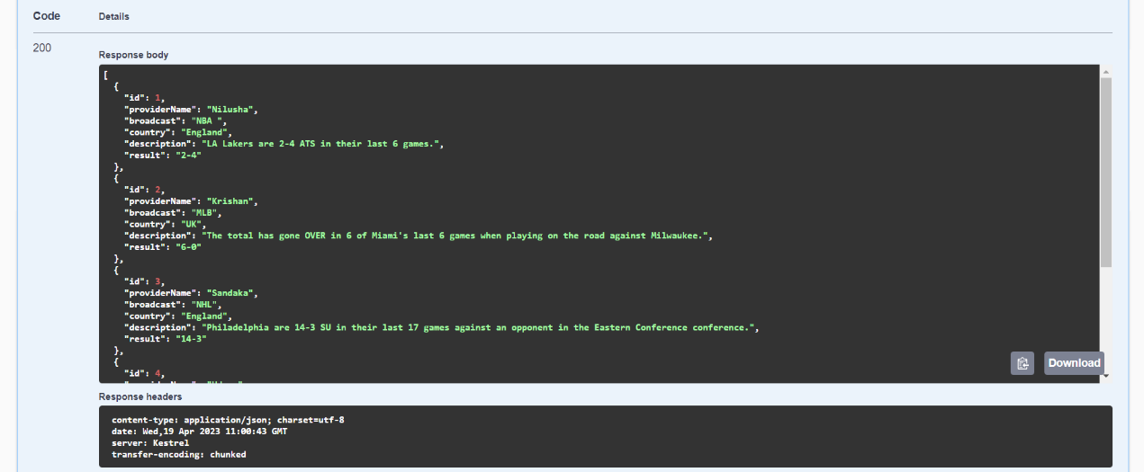
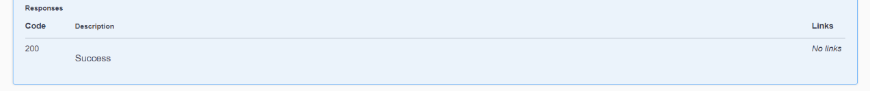
View All Content Details

Slide 40
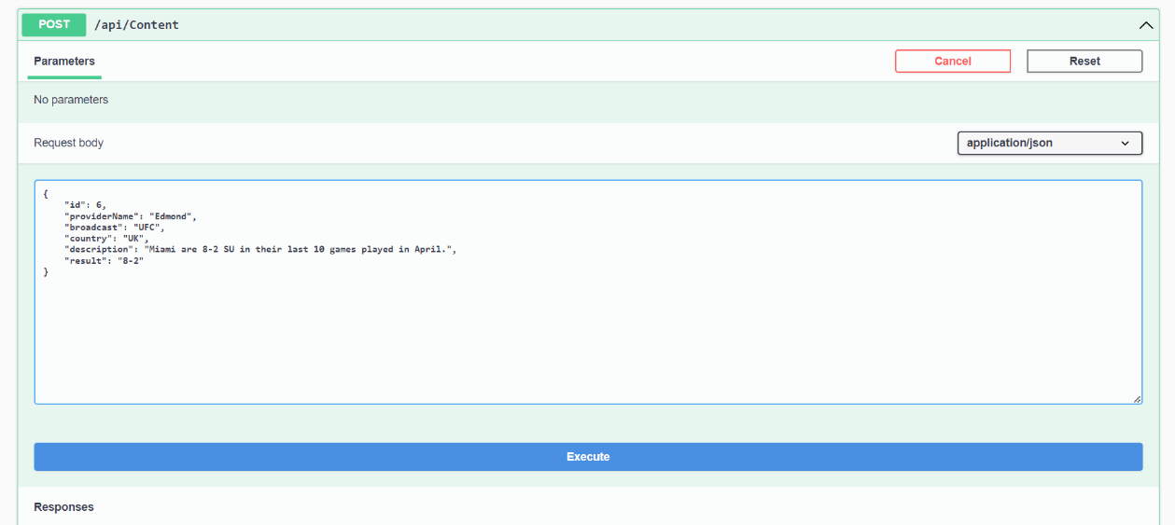
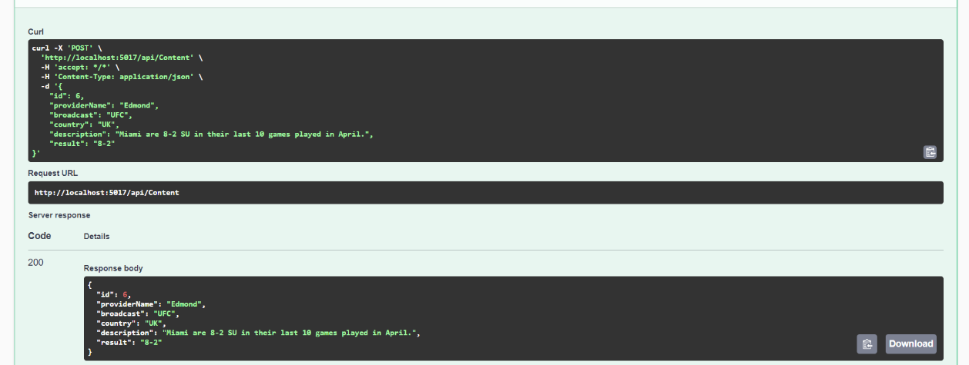
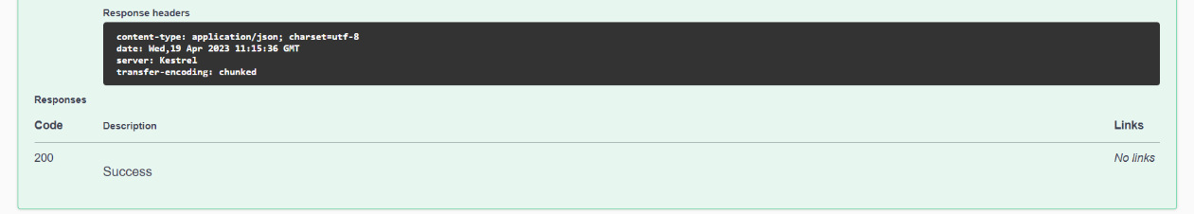
Add Content Details

Slide 41
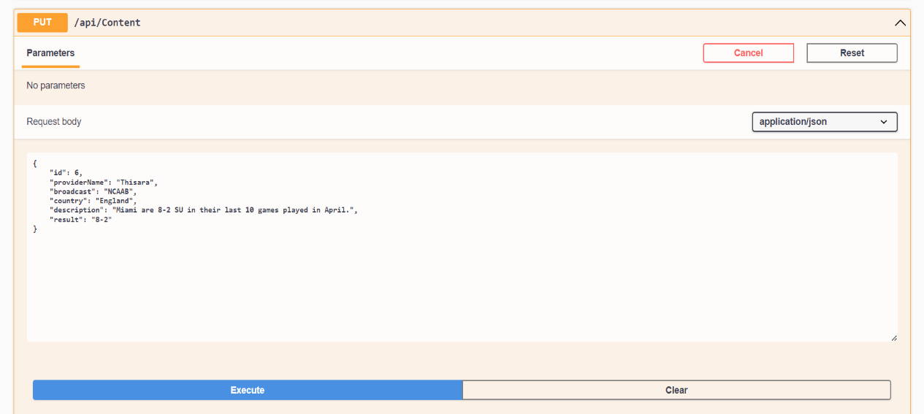
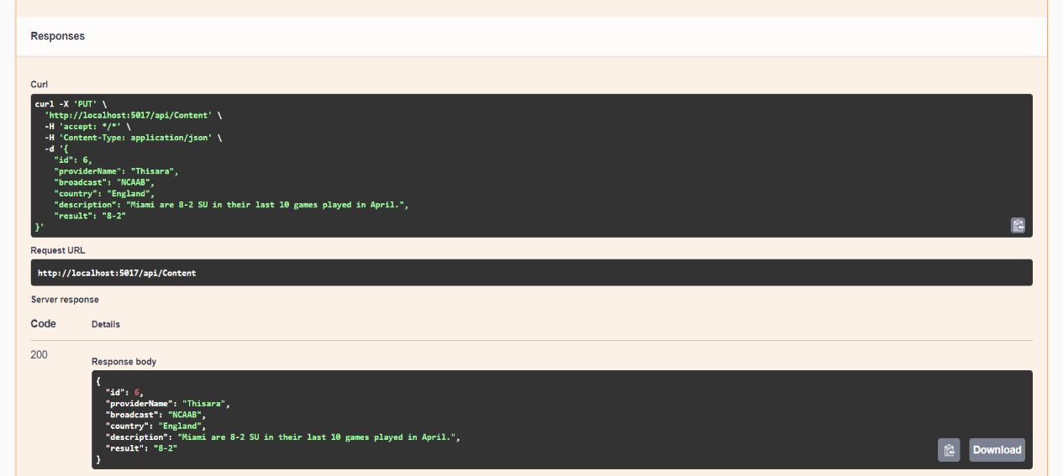
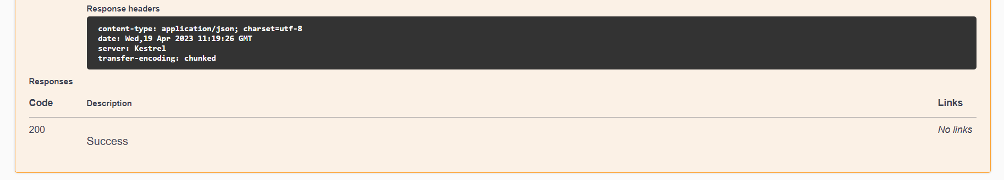
Update Content Details

Slide 42


Search Content Details

Slide 43


Delete Content Details

Slide 44


Test the Upstream Content Provider URL in Browser

Slide 45
Individual Contribution
Registration Number | Name | Contribution
IT20127114 | Kaluarachchi P. L. | Customer Microservice Add Customer View Customer Search Customer Update Customer Delete Customer
IT20246228 | Ranaweera E. T. M | Payment Microservice Add Payment View Payment Search Payment Update Payment Delete Payment
IT20115302 | Wadasinghe D. V. | Event Microservice Add Event View Event Search Event Update Event Delete Event
IT20004286 | Amarasinghe J. V. A. | Content Providers Microservice Add Content Provider View Content Provider Search Content Provider Update Content Provider Delete Content Provider

Slide 46
Source Code
GitHub: pawanlaksahan/MTIT-MicroServices (github.com)

Slide 47
References
https://microservices.io/patterns/apigateway.html
https://www.techtarget.com/searchapparchitecture/definition/microservices
https://www.redhat.com/en/topics/api/what-does-an-api-gateway-do
https://www.techtarget.com/whatis/definition/API-gateway-application-programming-interface-gateway

Slide 48
Thank You

